Slide 1


CS 153: Concepts of Compiler Design September 15 Class Meeting
Department of Computer Science San Jose State University Fall 2020 Instructor: Ron Mak
www.cs.sjsu.edu/~mak

Slide 2
Example ANTLR Grammar File
Expr.g4
grammar Expr;
program: statement+ ;
statement : expr NEWLINE
| IDENTIFER '=' expr NEWLINE
| NEWLINE
;
expr: expr ('*'|'/') expr
| expr ('+'|'-') expr
| INTEGER
| IDENTIFER
| '(' expr ')'
;
IDENTIFER : [a-zA-Z]+ ;
INTEGER : [0-9]+ ;
NEWLINE : '\r'? '\n' ;
WS : [ \t]+ -> skip ;
One or more statements.
input.txt
193
a = 5
b = 6
a+b*2
(1+2)*3
One or more lower- or upper-case letters.
One or more digits.
The line-feed character optionally preceded by the carriage-return character.
Skip whitespace characters.

Slide 3
A Java Main Program for ANTLR
import org.antlr.v4.runtime.*;
import org.antlr.v4.runtime.tree.*;
import java.io.FileInputStream;
import java.io.IOException;
public class ExprMain
{
public static void main(String[] args)
{
String sourceFileName = args[0];
FileInputStream source = null; // input stream
CharStream chars = null; // character stream
try
{
source = new FileInputStream(sourceFileName);
chars = CharStreams.fromStream(source);
}
catch (IOException ex)
{
System.out.println("Source file error: " + sourceFileName);
System.exit(-1);
}
ExprMain.java
Create the input stream.
Create the character stream.
Demo

Slide 4
A Java Main Program for ANTLR, cont’d
// Create a lexer which scans the character stream
// to create a token stream.
ExprLexer lexer = new ExprLexer(chars);
CommonTokenStream tokens = new CommonTokenStream(lexer);
// Print the token stream.
System.out.println("Tokens:");
tokens.fill();
for (Token token : tokens.getTokens())
{
System.out.println(token.toString());
}
// Create a parser which parses the token stream
// to create a parse tree.
ExprParser parser = new ExprParser(tokens);
ParseTree tree = parser.program();
// Print the parse tree in Lisp format.
System.out.println("\nParse tree (Lisp format):");
System.out.println(tree.toStringTree(parser));
}
}

Slide 5
Environment Setup
First set up your environment, or create equivalent shell scripts.
Use your own file paths, of course.
export ANTLR_JAR="$HOME/ANTLR-4.8/antlr-4.8-complete.jar"
export CLASSPATH="$CLASSPATH:$ANTLR_JAR"
alias antlr4="java -jar $ANTLR_JAR"
alias grun='java org.antlr.v4.gui.TestRig'

Slide 6
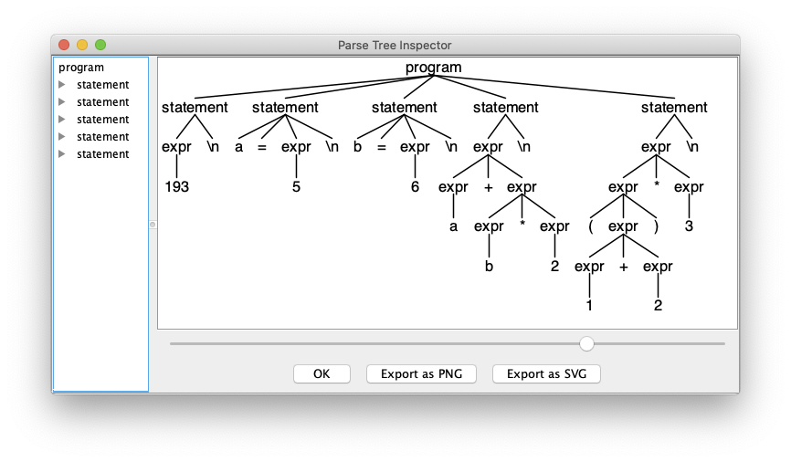
On the Command Line
ANTLR-ExprTestJava: ls
Expr.g4 ExprMain.java input.txt
ANTLR-ExprTestJava: antlr4 Expr.g4
ANTLR-ExprTestJava: ls
Expr.g4 ExprBaseListener.java ExprLexer.tokens ExprParser.java
Expr.interp ExprLexer.interp ExprListener.java input.txt
Expr.tokens ExprLexer.java ExprMain.java
ANTLR-ExprTestJava: javac Expr*.java
ANTLR-ExprTestJava: grun Expr program -gui input.txt

Slide 7
On the Command Line, cont’d
ANTLR-ExprTestJava: java ExprMain input.txt
Tokens:
[@0,0:2='193',<9>,1:0]
[@1,3:3='\n',<10>,1:3]
[@2,4:4='a',<8>,2:0]
[@3,6:6='=',<1>,2:2]
[@4,8:8='5',<9>,2:4]
[@5,9:9='\n',<10>,2:5]
[@6,10:10='b',<8>,3:0]
[@7,12:12='=',<1>,3:2]
[@8,14:14='6',<9>,3:4]
[@9,15:15='\n',<10>,3:5]
[@10,16:16='a',<8>,4:0]
[@11,17:17='+',<4>,4:1]
[@12,18:18='b',<8>,4:2]
[@13,19:19='*',<2>,4:3]
[@14,20:20='2',<9>,4:4]
[@15,21:21='\n',<10>,4:5]
[@16,22:22='(',<6>,5:0]
[@17,23:23='1',<9>,5:1]
[@18,24:24='+',<4>,5:2]
[@19,25:25='2',<9>,5:3]
[@20,26:26=')',<7>,5:4]
[@21,27:27='*',<2>,5:5]
[@22,28:28='3',<9>,5:6]
[@23,29:29='\n',<10>,5:7]
[@24,30:29='<EOF>',<-1>,6:0]
Parse tree (Lisp format):
(program (statement (expr 193) \n) (statement a = (expr 5) \n) (statement b = (expr 6) \n)
(statement (expr (expr a) + (expr (expr b) * (expr 2))) \n)
(statement (expr (expr ( (expr (expr 1) + (expr 2)) )) * (expr 3)) \n))

Slide 8
What Does ANTLR Do for Us?
Generate a lexer (scanner) based on the token specifications (regular expressions) in the grammar file.
Generate a parser based on the production rules in the grammar file.
Generate visit interfaces and default visit methods for the back end.
Create graphical syntax diagrams and parse trees from the grammar and source files.
Expr.g4
ExprLexer
ExprParser
ExprVisitor
ExprBaseVisitor

Slide 9
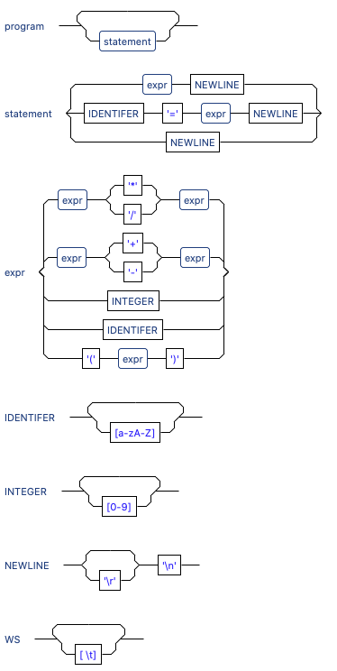
Syntax Diagrams (Eclipse Plugin)

Slide 10
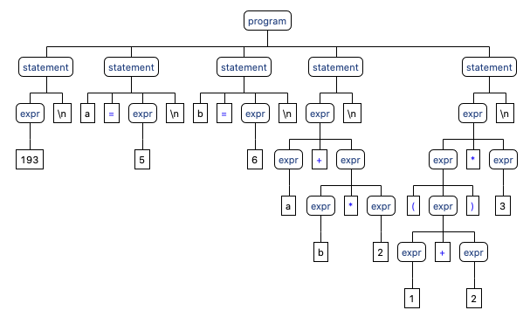
Parse Tree (Eclipse Plugin)

Slide 11
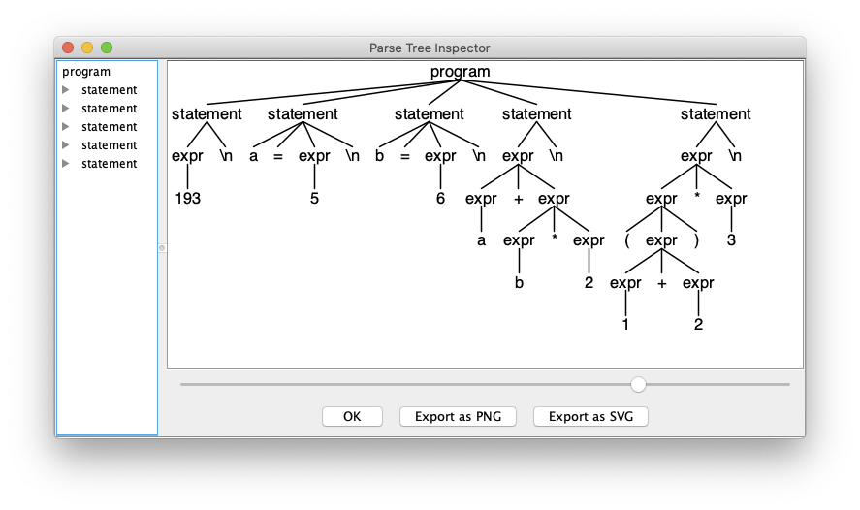
Parse Tree (Command Line)
alias grun='java org.antlr.v4.gui.TestRig'
grun Expr program -gui input.txt
grun is a Java program that
provides a main for the
generated lexer and parser.

Slide 12
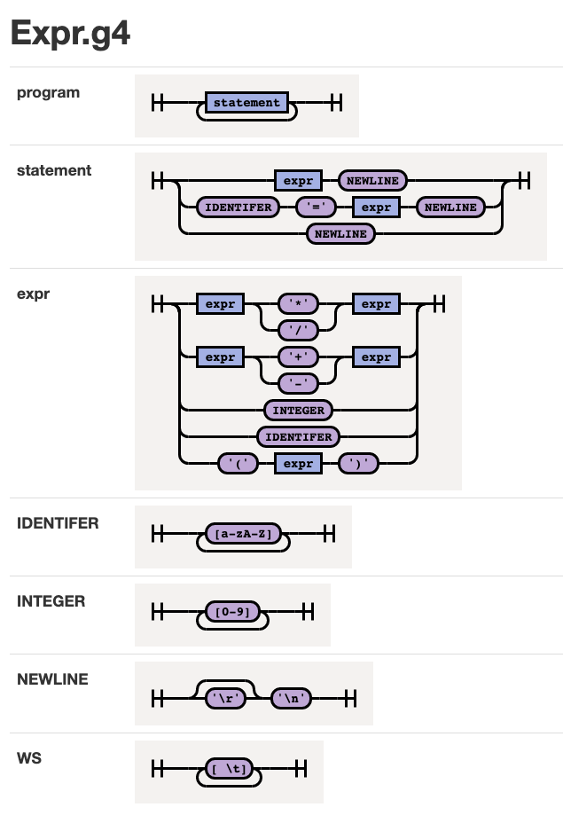
Syntax Diagram (Command Line)
java -jar rrd-antlr4-0.1.2.jar Expr.g4
https://github.com/bkiers/rrd-antlr4

Slide 13
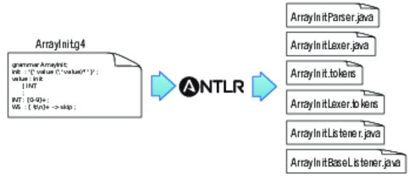
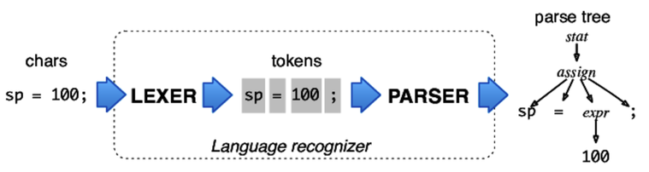
ANTLR Workflow
Generate compiler components based on the .g4 grammar file:
Use the generated components on a source file:
The Definitive ANTLR 4 Reference
by Terence Parr
The Pragmatic Programmers, 2012

Slide 14
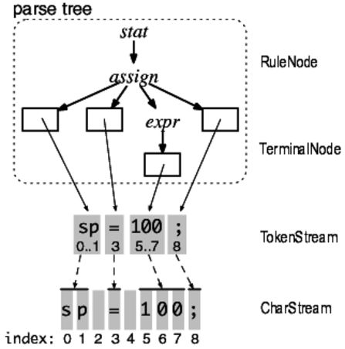
ANTLR Parse Trees
A token stream is the “pipe” between the lexer and the parser.
Each token object records the start and stop character indexes in the character stream.
The Definitive ANTLR 4 Reference
by Terence Parr
The Pragmatic Programmers, 2012

Slide 15
ANTLR Parse Trees, cont’d
ANTLR generates a RuleNode subclass for each grammar rule.
They are called context objects because they record everything about the recognition phase of a rule.
The Definitive ANTLR 4 Reference
by Terence Parr
The Pragmatic Programmers, 2012

Slide 16
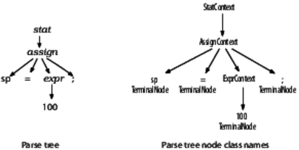
ANTLR Parse Trees, cont’d
The ANTLR-generated parser has corresponding parse tree node class names.
The Definitive ANTLR 4 Reference
by Terence Parr
The Pragmatic Programmers, 2012

Slide 17
Syntax Error Handling
An ANTLR-generated parser has basic syntax error handling and recovery.
You can improve the error handling.
193
a = 5
b = 6
(a+b*2
(1+2)*3
Parse tree (Lisp format):
(prog
(stat (expr 193) \n)
(stat a = (expr 5) \n)
(stat b = (expr 6) \n)
(stat (expr ( (expr (expr a) + (expr (expr b) * (expr 2))) <missing ')'>) \n)
(stat (expr (expr ( (expr (expr 1) + (expr 2)) )) * (expr 3)) \n))
line 4:6 missing ')' at '\n'

Slide 18
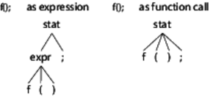
Resolving Ambiguities
Is f() a function call as a standalone statement, or a function call in an expression?
stat: expr ';'
| ID '(' ')' ';'
;
expr: ID '(' ')'
| INT
;
The Definitive ANTLR 4 Reference
by Terence Parr
The Pragmatic Programmers, 2012

Slide 19
Resolving Ambiguities, cont’d
Is begin a reserved word or an identifier?
ANTLR resolves an ambiguity by choosing the first alternative in the grammar.
BEGIN : 'begin' ;
ID : [a-z]+ ;

Slide 20
The Visitor Interface
We want ANTLR to generate the visitor interface for our back end.
By default, it generates the listener interface which we won’t use in this class.

Slide 21
The Visitor Interface, cont’d
Specify “visitor” and “no listener” when you run ANTLR to generate components.
Command line:
alias antlr4='java -jar /Users/rmak/ANTLR-4.8/antlr-4.8-complete.jar'
ANTLR-ExprTestJava: antlr4 -no-listener -visitor Expr.g4
ANTLR-ExprTestJava: ls
Expr.g4 Expr.tokens ExprLexer.interp ExprLexer.tokens ExprParser.java input.txt
Expr.interp ExprBaseVisitor.java ExprLexer.java ExprMain.java ExprVisitor.java

Slide 22
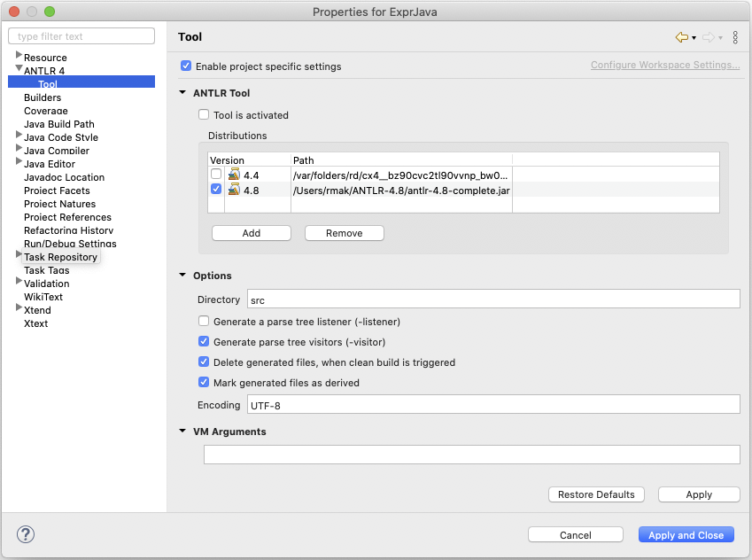
The Visitor Interface, cont’d
Specify “visitor” and “no listener” when you run ANTLR to generate components.
Eclipse (project properties):

Slide 23
Interface ExprVisitor
ExprVisitor.java
// Generated from Expr.g4 by ANTLR 4.8
import org.antlr.v4.runtime.tree.ParseTreeVisitor;
/**
* This interface defines a complete generic visitor for a parse tree produced
* by {@link ExprParser}.
*
* @param <T> The return type of the visit operation. Use {@link Void} for
* operations with no return type.
*/
public interface ExprVisitor<T> extends ParseTreeVisitor<T>
{
T visitProgram(ExprParser.ProgramContext ctx);
T visitStatement(ExprParser.StatementContext ctx);
T visitExpr(ExprParser.ExprContext ctx);
}
You can think of each ctx as
a pointer to a parse tree node.
statement : expr NEWLINE
| IDENTIFER '=' expr NEWLINE
| NEWLINE
;
expr : expr ('*'|'/') expr
| expr ('+'|'-') expr
| INTEGER
| IDENTIFER
| '(' expr ')'
;

Slide 24
The Base Visitor Class ExprBaseVisitor
// Generated from Expr.g4 by ANTLR 4.8
import org.antlr.v4.runtime.tree.AbstractParseTreeVisitor;
/**
* This class provides an empty implementation of {@link ExprVisitor},
* which can be extended to create a visitor which only needs to handle a subset
* of the available methods.
*
* @param <T> The return type of the visit operation. Use {@link Void} for
* operations with no return type.
*/
public class ExprBaseVisitor<T> extends AbstractParseTreeVisitor<T>
implements ExprVisitor<T>
{
@Override public T visitProgram(ExprParser.ProgramContext ctx)
{
return visitChildren(ctx);
}
@Override public T visitStatement(ExprParser.StatementContext ctx)
{
return visitChildren(ctx);
}
@Override public T visitExpr(ExprParser.ExprContext ctx)
{
return visitChildren(ctx);
}
}
ExprBaseVisitor.java

Slide 25
The Base Visitor Class, cont’d
Each default visit method in the base visitor class ExprBaseVisitor simply visits the parse tree node’s children.
If the node has no children, then nothing happens.
So all the default methods accomplish is to visit each node of the tree and nothing else.
Therefore, to do real work in the back end, we must create a subclass of ExprBaseVisitor where we override the default visit methods.
ANTLR has created a framework for our back end.

Slide 26
The Base Visitor Class, cont’d
ANTLR generated a separate visit method for each production rule:
visitProgram
visitStatement
visitExpr
But that’s too “course” since some rules have multiple options:
statement : expr NEWLINE
| IDENTIFER '=' expr NEWLINE
| NEWLINE
;
expr : expr ('*'|'/') expr
| expr ('+'|'-') expr
| INTEGER
| IDENTIFER
| '(' expr ')'
;
Expr.g4

Slide 27
Labeled Production Rules
Add a # label to each rule option and rerun ANTLR to generate a new parser:
grammar ExprLabeled;
program: statement+ ;
statement : expr NEWLINE # print
| IDENTIFER '=' expr NEWLINE # assign
| NEWLINE # empty
;
expr : expr ('*'|'/') expr # mulDiv
| expr ('+'|'-') expr # addSub
| INTEGER # int
| IDENTIFER # id
| '(' expr ')' # parens
;
These are labels,
not comments!
ExprLabeled.g4

Slide 28
Interface ExprLabeledVisitor
ExprLabeledVisitor.java
// Generated from ExprLabeled.g4 by ANTLR 4.8
import org.antlr.v4.runtime.tree.ParseTreeVisitor;
public interface ExprLabeledVisitor<T> extends ParseTreeVisitor<T>
{
T visitProgram(ExprLabeledParser.ProgramContext ctx);
T visitPrint(ExprLabeledParser.PrintContext ctx);
T visitAssign(ExprLabeledParser.AssignContext ctx);
T visitEmpty(ExprLabeledParser.EmptyContext ctx);
T visitParens(ExprLabeledParser.ParensContext ctx);
T visitAddSub(ExprLabeledParser.AddSubContext ctx);
T visitId(ExprLabeledParser.IdContext ctx);
T visitInt(ExprLabeledParser.IntContext ctx);
T visitMulDiv(ExprLabeledParser.MulDivContext ctx);
}
program: statement+ ;
statement : expr NEWLINE # print
| IDENTIFER '=' expr NEWLINE # assign
| NEWLINE # empty
;
expr : expr ('*'|'/') expr # mulDiv
| expr ('+'|'-') expr # addSub
| INTEGER # int
| IDENTIFER # id
| '(' expr ')' # parens
;

Slide 29
Base Class ExprLabeledBaseVisitor
As before, the default implementation of each method is to visit the node’s children.
// Generated from ExprLabeled.g4 by ANTLR 4.8
import org.antlr.v4.runtime.tree.AbstractParseTreeVisitor;
public class ExprLabeledBaseVisitor<T> extends AbstractParseTreeVisitor<T>
implements ExprLabeledVisitor<T>
{
@Override public T visitProgram(ExprLabeledParser.ProgramContext ctx)
{
return visitChildren(ctx);
}
@Override public T visitPrint(ExprLabeledParser.PrintContext ctx)
{
return visitChildren(ctx);
}
...
}
ExprLabeledBaseVisitor.java

Slide 30
Class Executor
statement : expr NEWLINE # print
| IDENTIFIER '=' expr NEWLINE # assign
| NEWLINE # empty
;
Executor.java
public class Executor extends ExprLabeledBaseVisitor<Integer>
{
// The symbol table to store runtime values (our hack).
Map<String, Integer> symtab = new HashMap<String, Integer>();
@Override
public Integer visitAssign(ExprLabeledParser.AssignContext ctx)
{
String idName = ctx.IDENTIFIER().getText();
int value = visit(ctx.expr()); // compute the expression value
symtab.put(idName, value); // store it into the symbol table
return value;
}

Slide 31
Class Executor, cont’d
statement : expr NEWLINE # print
| IDENTIFIER '=' expr NEWLINE # assign
| NEWLINE # empty
;
Executor.java
@Override
public Integer visitPrint(ExprLabeledParser.PrintContext ctx)
{
Integer value = visit(ctx.expr()); // evaluate the expression
System.out.println(value); // print the result
return null;
}

Slide 32
Class Executor, cont’d
expr : expr op=('*'|'/') expr # mulDiv
| expr op=('+'|'-') expr # addSub
| INTEGER # int
| IDENTIFIER # id
| '(' expr ')' # parens
;
Executor.java
@Override
public Integer visitInt(ExprLabeledParser.IntContext ctx)
{
return Integer.valueOf(ctx.INTEGER().getText()); // integer value
}
@Override
public Integer visitId(ExprLabeledParser.IdContext ctx)
{
String id = ctx.IDENTIFIER().getText();
if (symtab.containsKey(id)) return symtab.get(id); // value from symtab
else return 0; // dummy value
}

Slide 33
Class Executor, cont’d
expr : expr op=('*'|'/') expr # mulDiv
| expr op=('+'|'-') expr # addSub
| INTEGER # int
| IDENTIFIER # id
| '(' expr ')' # parens
;
MUL : '*' ;
DIV : '/' ;
ADD : '+' ;
SUB : '-' ;
@Override
public Integer visitMulDiv(ExprLabeledParser.MulDivContext ctx)
{
int left = visit(ctx.expr(0)); // evaluate left child expression
int right = visit(ctx.expr(1)); // evaluate right child expression
if (ctx.op.getType() == ExprLabeledParser.MUL) return left*right;
else return left/right;
}
Executor.java

Slide 34
Class Executor, cont’d
expr : expr op=('*'|'/') expr # mulDiv
| expr op=('+'|'-') expr # addSub
| INTEGER # int
| IDENTIFIER # id
| '(' expr ')' # parens
;
MUL : '*' ;
DIV : '/' ;
ADD : '+' ;
SUB : '-' ;
@Override
public Integer visitAddSub(ExprLabeledParser.AddSubContext ctx)
{
int left = visit(ctx.expr(0)); // evaluate left child expression
int right = visit(ctx.expr(1)); // evaluate right child expression
if (ctx.op.getType() == ExprLabeledParser.ADD) return left + right;
else return left - right;
}
Executor.java

Slide 35
Class Executor, cont’d
expr : expr op=('*'|'/') expr # mulDiv
| expr op=('+'|'-') expr # addSub
| INTEGER # int
| IDENTIFIER # id
| '(' expr ')' # parens
;
MUL : '*' ;
DIV : '/' ;
ADD : '+' ;
SUB : '-' ;
Executor.java
@Override
public Integer visitParens(ExprLabeledParser.ParensContext ctx)
{
return visit(ctx.expr()); // return parenthesized expression value
}

Slide 36
Main Class ExprLabeledMain
ExprLabeledMain.java
import org.antlr.v4.runtime.*;
import org.antlr.v4.runtime.tree.*;
import java.io.FileInputStream;
import java.io.IOException;
public class ExprLabeledMain
{
public static void main(String[] args)
{
...
// Create a parser which parses the token stream
// to create a parse tree.
ExprLabeledParser parser = new ExprLabeledParser(tokens);
ParseTree tree = parser.program();
// Execution.
System.out.println("Execution:");
Executor executor = new Executor();
executor.visit(tree);
}
}

